Slide 1
NoSQL
-By Jagadish Rouniyar

Slide 2
Contents
Structured and unstructured data
Taxonomy of NoSQL implementation
Hbase
Cassandra
MongoDB

Slide 3
Structured and unstructured data
Types of Data
Structured
Semi-structured
Unstructured
3

Slide 4
Structured Data
“normal” RDBMS data
Format is known and defined
Example: Sales Order
4

Slide 5
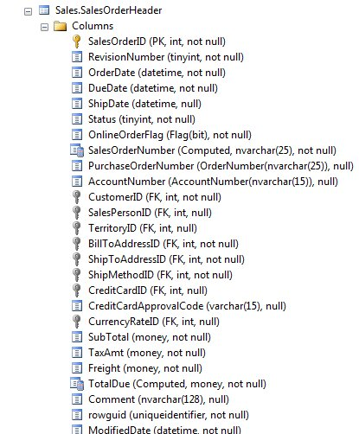

Slide 6
Semi-structured Data
some structure, but it is fluid
changes in structure should not break code
example: XML
6

Slide 7
Semi Structured Data
<SalesOrder DueDate=”20120201”>
<OrderID>12</OrderID>
<Customer>John Doe</Customer>
<OrderDate>2012/01/15</OrderDate>
<Items>
<Item>
<Product>Widget</Product>
<Quantity>12</Quantity>
</Item>
<Item>
<Product>Whatchamacallit</Product>
<Quantity>2</Quantity>
</Item>
</Items>
</SalesOrder>
7

Slide 8
Semi Structured Data
<SalesOrder DueDate=”20120201”>
<OrderID>12</OrderID>
<Customer>John Doe</Customer>
<OrderDate>2012/01/15</OrderDate>
<Items>
<Item>
<Product>Widget</Product>
<Quantity>12</Quantity>
</Item>
<Item>
<Product>Whatchamacallit</Product>
<Quantity>2</Quantity>
</Item>
</Items>
</SalesOrder>
8

Slide 9
Semi Structured Data
<SalesOrder DueDate=”20120201”>
<OrderID>12</OrderID>
<Customer>John Doe</Customer>
<OrderDate>2012/01/15</OrderDate>
<Items>
<Item>
<Product>Widget</Product>
<Quantity>12</Quantity>
</Item>
<Item>
<Product>Whatchamacallit</Product>
<Quantity>2</Quantity>
</Item>
</Items>
</SalesOrder>
9

Slide 10
Unstructured Data
structure is merely encoding.
meta data may be in the structure
examples:
Audio files
Word Documents
PDF
Movies
10

Slide 11
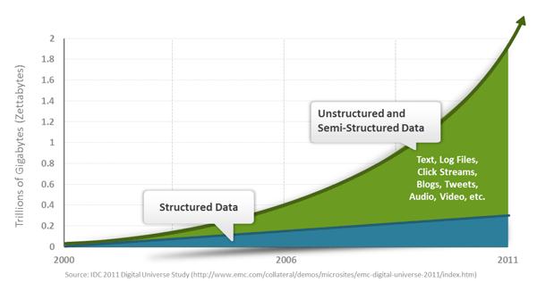

Slide 12
NoSQL
Overview of NoSQL databases
The need of NoSQL databases
“Battle” between SQL and NoSQL databases
CAP Theorem
Challenges of NoSQL databases

Slide 13
NoSQL: An Overview of NoSQL Databases
the term means Not Only SQL
It's not SQL and it's not relational. NoSQL is designed for distributed data stores for very large scale data needs.
In a NoSQL database, there is no fixed schema and no joins. Scaling out refers to spreading the load over many commodity systems. This is the component of NoSQL that makes it an inexpensive solution for large datasets.

Slide 14
Querying NoSQL
The question of how to query a NoSQL database is what most developers are interested in. After all, data stored in a huge database doesn't do anyone any good if you can't retrieve and show it to end users or web services. NoSQL databases do not provide a high level declarative query language like SQL. Instead, querying these databases is data-model specific.
Many of the NoSQL platforms allow for RESTful interfaces to the data. Other offer query APIs. There are a couple of query tools that have been developed that attempt to query multiple NoSQL databases. These tools typically work accross a single NoSQL category. One example is SPARQL. SPARQL is a declarative query specification designed for graph databases. Here is an example of a SPARQL query that retrieves the URL of a particular blogger (courtesy of IBM):
PREFIX foaf: <http://xmlns.com/foaf/0.1/> SELECT ?url FROM <bloggers.rdf> WHERE { ?contributor foaf:name "Jon Foobar" . ?contributor foaf:weblog ?url . }

Slide 15
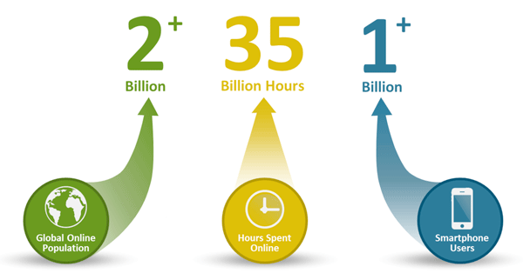
Why NoSQL?
Three trends disrupting the database status quo– Big Data, Big Users, and Cloud Computing
Big Users :Not that long ago, 1,000 daily users of an application was a lot and 10,000 was an extreme case. Today, with the growth in global Internet use, the increased number of hours users spend online, and the growing popularity of smartphones and tablets, it's not uncommon for apps to have millions of users a day.

Slide 16
Why NoSQL?
Big Data :Data is becoming easier to capture and access through third parties such as Facebook, D&B, and others. Personal user information, geo location data, social graphs, user-generated content, machine logging data, and sensor-generated data are just a few examples of the ever-expanding array of data being captured.
Cloud Computing: Today, most new applications (both consumer and business) use a three-tier Internet architecture, run in a public or private cloud, and support large numbers of users.

Slide 17
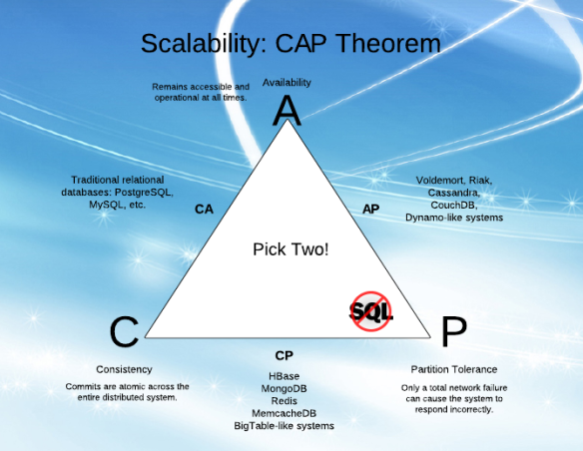
What Is CAP?
The CAP Theorem states that it is impossible for any shared-data system to guarantee simultaneously all of the following three properties: consistency, availability and partition tolerance.

Slide 18
What Is CAP?
Consistency in CAP is not the same as consistency in ACID (that would be too easy). According to CAP, consistency in a database means that whenever data is written, everyone who reads from the database will always see the latest version of the data. A database without strong consistency means that when the data is written, not everyone who reads from the database will see the new data right away; this is usually called eventual-consistency or weak consistency.
Availability in a database according to CAP means you always can expect the database to be there and respond whenever you query it for information. High availability usually is accomplished through large numbers of physical servers acting as a single database through sharing (splitting the data between various database nodes) and replication (storing multiple copies of each piece of data on different nodes).
Partition tolerance in a database means that the database still can be read from and written to when parts of it are completely inaccessible. Situations that would cause this include things like when the network link between a significant number of database nodes is interrupted. Partition tolerance can be achieved through some sort of mechanism whereby writes destined for unreachable nodes are sent to nodes that are still accessible. Then, when the failed nodes come back, they receive the writes they missed

Slide 19
NOSQL: Taxonomy of Implementation
The current NoSQL world fits into 4 basic categories.
Key-values Stores
Column Family Stores were created to store and process very large amounts of data distributed over many machines. There are still keys but they point to multiple columns. In the case of BigTable (Google's Column Family NoSQL model), rows are identified by a row key with the data sorted and stored by this key. The columns are arranged by column family. E.g. Cassandra
Document Databases were inspired by Lotus Notes and are similar to key-value stores. The model is basically versioned documents that are collections of other key-value collections. The semi-structured documents are stored in formats like JSON e.g. MongoDB
Graph Databases are built with nodes, relationships between notes and the properties of nodes. Instead of tables of rows and columns and the rigid structure of SQL, a flexible graph model is used which can scale across many machines.

Slide 20
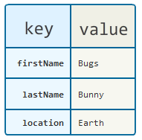
Key-values Stores
The Key-Value database is a very simple structure based on Amazon’s Dynamo DB. Data is indexed and queried based on it’s key. Key-value stores provide consistent hashing so they can scale incrementally as your data scales. They communicate node structure through a gossip-based membership protocol to keep all the nodes synchronized. If you are looking to scale very large sets of low complexity data, key-value stores are the best option.
Examples
Riak
Voldemort
Tokyo Cabinet

Slide 21
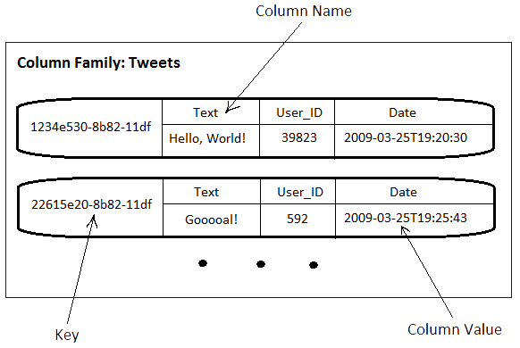
Column Family Stores

Slide 22
Column Family Stores
These data stores are based on Google’s BigTable implementation. They may look similar to relational databases on the surface but under the hood a lot has changed. A column family database can have different columns on each row so is not relational and doesn’t have what qualifies in an RDBMS as a table. The only key concepts in a column family database are columns, column families and super columns. All you really need to start with is a column family. Column families define how the data is structured on disk. A column by itself is just a key-value pair that exists in a column family. A super column is like a catalogue or a collection of other columns except for other super columns.
Column family databases are still extremely scalable but less-so than key-value stores. However, they work better with more complex data sets.
Examples of Column family databases are:
Apache HBase
Hypertable
Cassandra

Slide 23
Column Family Stores
Equivalent to “relational table” – “set of rows” identified by key
Concept starts with columns
Data is organized in the columns
Columns are stored contiguously
Columns tend to have similar data
A row can have as many columns as needed
Columns are essentially keys, that can let you lookup values in the rows
Columns can be added any time, NULL don’t exist
Unused columns in a row does not occupy storage
Write Data to Append Only file, an extremely efficient and makes write are significantly faster then write
Built in control about replication and distribution
HBase :From CAP Theorem
Partition Tolerance
Consistency
Cassandra :From CAP Theorem
Partition Tolerance
Availability Note: Tradeoff between availability and consistency is tunable

Slide 24
Document Databases
A document database is not a new idea. It was used to power one of the more prominent communication platforms of the 90’s and still in service today, Lotus Notes now called Lotus Domino. APIs for document DBs use Restful web services and JSON for message structure making them easy to move data in and out.
A document database has a fairly simple data model based on collections of key-value pairs.
A typical record in a document database would look like this:
{ “Subject”: “I like Plankton” “Author”: “Rusty” “PostedDate”: “5/23/2006″ “Tags”: ["plankton", "baseball", "decisions"] “Body”: “I decided today that I don’t like baseball. I like plankton.” }
Document databases improve on handling more complex structures but are slightly less scalable than column family databases.
Examples of document databases are:
CouchDB
MongoDB

Slide 25
Document Databases
Documents are key-value pair
document can also be stroed in JSON format
Because of JSON document considered as object
JSON documents are used as Key-Value pairs
Document can have any set of keys
Any key can associate with any arbitrarily complex value, that is itself a JSON document
Documents are added with different sets of keys
Missing keys
Extra keys
Add keys in future when in need
Application must know that certain key present
Queries are made on Keys
Index are set to keys to make search efficient

Slide 26
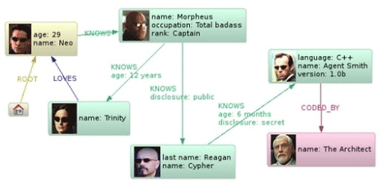
Graph Databases

Slide 27
Graph Databases
Graph databases take document databases to the extreme by introducing the concept of type relationships between documents or nodes. The most common example is the relationship between people on a social network such as Facebook. The idea is inspired by the graph theory work by Leonhard Euler, the 18th century mathematician. Key/Value stores used key-value pairs as their modeling units. Column Family databases use the tuple with attributes to model the data store. A graph database is a big dense network structure.
While it could take an RDBMS hours to sift through a huge linked list of people, a graph database uses sophisticated shortest path algorithms to make data queries more efficient. Although slower than its other NoSQL counterparts, a graph database can have the most complex structure of them all and still traverse billions of nodes and relationships with light speed.
Examples of Graph Databases are:
AllegroGraph
Sones
Neo4j

Slide 28

HBase: Overview
HBase is a distributed column-oriented data store built on top of HDFS
HBase is an Apache open source project whose goal is to provide storage for the Hadoop Distributed Computing
Data is logically organized into tables, rows and columns

Slide 29
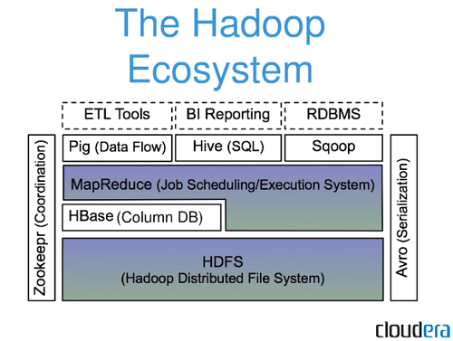
HBase: Part of Hadoop’s Ecosystem
HBase is built on top of HDFS
HBase files are internally stored in HDFS

Slide 30
HBase vs. HDFS (Cont’d)
HBase is designed to efficiently address the above points
Fast record lookup
Support for record-level insertion
Support for updates (not in place)
HBase updates are done by creating new versions of values

Slide 31
HBase Data Model

Slide 32
HBase Data Model
HBase is based on Google’s Bigtable model
Key-Value pairs

Slide 33
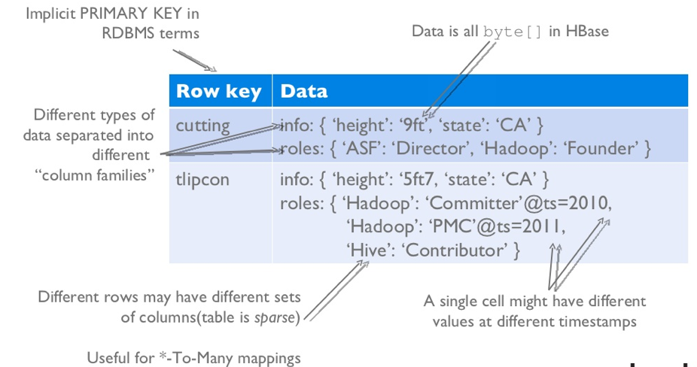
HBase Logical View

Slide 34
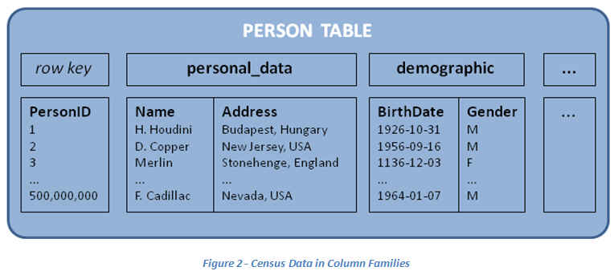
HBase: Keys and Column Families
Each record is divided into Column Families
Each row has a Key
Each column family consists of one or more Columns

Slide 35
Column family named “anchor”
Column family named “Contents”
Key
Byte array
Serves as the primary key for the table
Indexed far fast lookup
Column Family
Has a name (string)
Contains one or more related columns
Column
Belongs to one column family
Included inside the row
familyName:columnName
Column named “apache.com”

Slide 36
Version number for each row
Version Number
Unique within each key
By default→ System’s timestamp
Data type is Long
Value (Cell)
Byte array
value

Slide 37
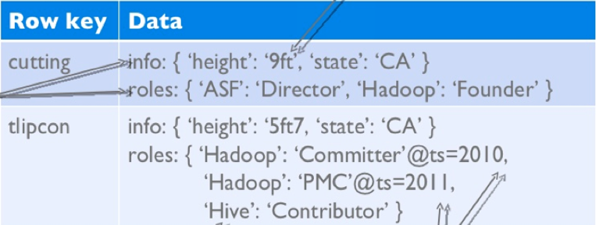
Notes on Data Model
HBase schema consists of several Tables
Each table consists of a set of Column Families
Columns are not part of the schema
HBase has Dynamic Columns
Because column names are encoded inside the cells
Different cells can have different columns
“Roles” column family has different columns in different cells

Slide 38
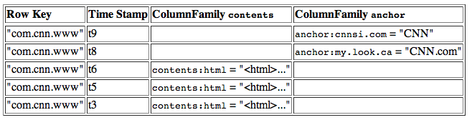
Notes on Data Model (Cont’d)
The version number can be user-supplied
Even does not have to be inserted in increasing order
Version number are unique within each key
Table can be very sparse
Many cells are empty
Keys are indexed as the primary key
Has two columns
[cnnsi.com & my.look.ca]

Slide 39
HBase Physical Model

Slide 40
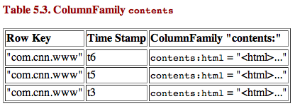
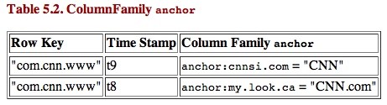
HBase Physical Model
Each column family is stored in a separate file (called HTables)
Key & Version numbers are replicated with each column family
Empty cells are not stored
HBase maintains a multi-level index on values:
<key, column family, column name, timestamp>

Slide 41
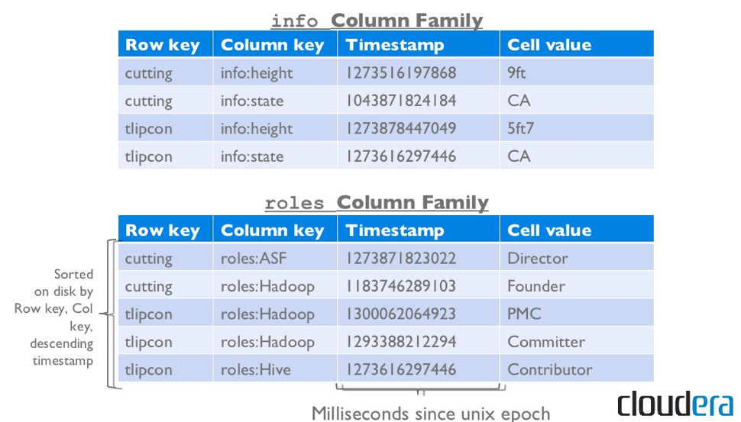
Example

Slide 42
HBase Regions
Each HTable (column family) is partitioned horizontally into regions
Regions are counterpart to HDFS blocks
Each will be one region

Slide 43
HBase Architecture

Slide 44
Three Major Components
The HBaseMaster
One master
The HRegionServer
Many region servers
The HBase client

Slide 45
HBase Components
Region
A subset of a table’s rows, like horizontal range partitioning
Automatically done
RegionServer (many slaves)
Manages data regions
Serves data for reads and writes (using a log)
Master
Responsible for coordinating the slaves
Assigns regions, detects failures
Admin functions

Slide 46
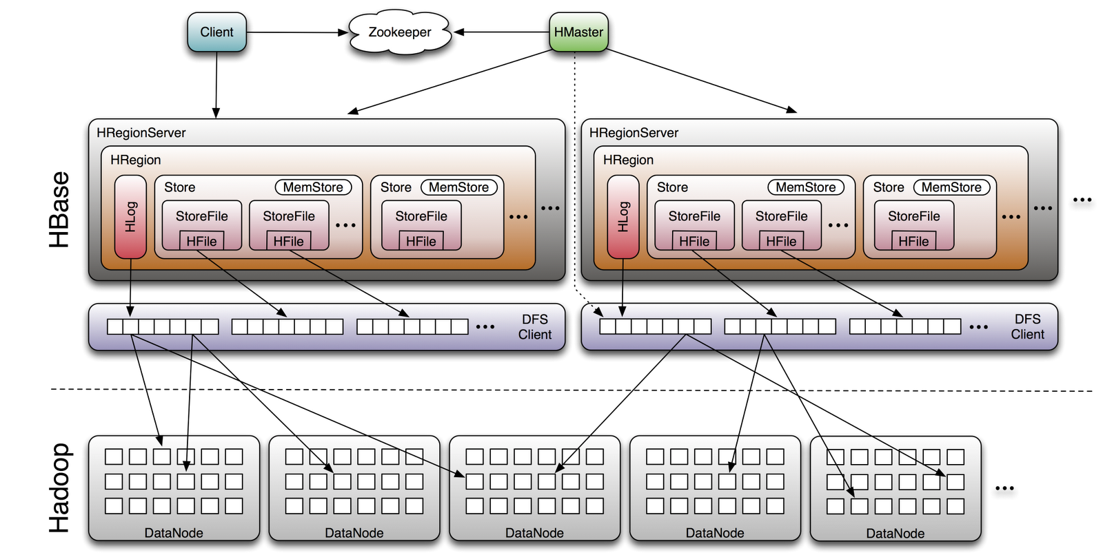
Big Picture

Slide 47
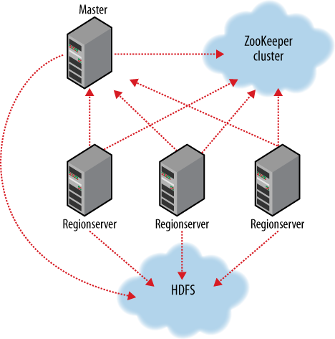
ZooKeeper
HBase depends on ZooKeeper
By default HBase manages the ZooKeeper instance
E.g., starts and stops ZooKeeper
HMaster and HRegionServers register themselves with ZooKeeper

Slide 48
Creating a Table
HBaseAdmin admin= new HBaseAdmin(config);
HColumnDescriptor []column;
column= new HColumnDescriptor[2];
column[0]=new HColumnDescriptor("columnFamily1:");
column[1]=new HColumnDescriptor("columnFamily2:");
HTableDescriptor desc= new HTableDescriptor(Bytes.toBytes("MyTable"));
desc.addFamily(column[0]);
desc.addFamily(column[1]);
admin.createTable(desc);

Slide 49
Operations On Regions: Get()
Given a key → return corresponding record
For each value return the highest version
Can control the number of versions you want

Slide 50
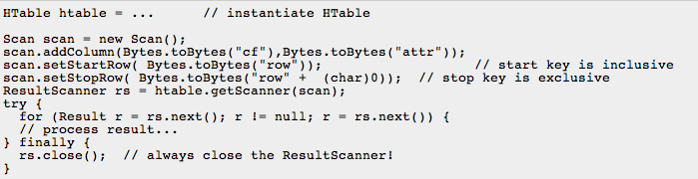
Operations On Regions: Scan()

Slide 51

Get()
Select value from table where key=‘com.apache.www’ AND label=‘anchor:apache.com’
Row key | Time Stamp | Column “anchor:”
“com.apache.www” | t12
 | t11
 | t10 | “anchor:apache.com” | “APACHE”
“com.cnn.www” | t9 | “anchor:cnnsi.com” | “CNN”
 | t8 | “anchor:my.look.ca” | “CNN.com”
 | t6
 | t5
 | t3

Slide 52
Scan()
Select value from table where anchor=‘cnnsi.com’
Row key | Time Stamp | Column “anchor:”
“com.apache.www” | t12
 | t11
 | t10 | “anchor:apache.com” | “APACHE”
“com.cnn.www” | t9 | “anchor:cnnsi.com” | “CNN”
 | t8 | “anchor:my.look.ca” | “CNN.com”
 | t6
 | t5
 | t3

Slide 53
Operations On Regions: Put()
Insert a new record (with a new key), Or
Insert a record for an existing key
Implicit version number
(timestamp)
Explicit version number

Slide 54
Operations On Regions: Delete()
Marking table cells as deleted
Multiple levels
Can mark an entire column family as deleted
Can make all column families of a given row as deleted
All operations are logged by the RegionServers
The log is flushed periodically

Slide 55
HBase: Joins
HBase does not support joins
Can be done in the application layer
Using scan() and get() operations

Slide 56
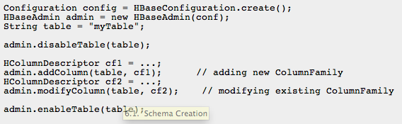
Altering a Table
Disable the table before changing the schema

Slide 57
Cassandra: Data Model
A table in Cassandra is a distributed multi dimensional map indexed by a key. The value is an object which is highly structured.
Simple column families
Cassandra exposes two kinds of columns families
Super column families

Slide 58
structure
keyspace
settings (eg, partitioner)
column family
settings (eg, comparator, type [Std])
column
name
value
clock

Slide 59
column family
group records of similar kind
not same kind, because CFs are sparse tables
ex:
User
Address
Tweet
PointOfInterest
HotelRoom

Slide 60
think of cassandra as row-oriented
each row is uniquely identifiable by key
rows group columns and super columns

Slide 61

column family
key123
user=eben
nickname=The Situation
key456
user=alison
icon=
n= 42

Slide 62
json-like notation
User {
123 : { email: alison@foo.com,
icon: },
456 : { email: eben@bar.com,
location: The Danger Zone}
}

Slide 63
0.6 example
$cassandra –f
$bin/cassandra-cli
cassandra> connect localhost/9160
cassandra> set Keyspace1.Standard1[‘eben’][‘age’]=‘29’
cassandra> set Keyspace1.Standard1[‘eben’][‘email’]=‘e@e.com’
cassandra> get Keyspace1.Standard1[‘eben'][‘age']
=> (column=6e616d65, value=39, timestamp=1282170655390000)

Slide 64
a column has 3 parts
name
byte[]
determines sort order
used in queries
indexed
value
byte[]
you don’t query on column values
timestamp
long (clock)
last write wins conflict resolution

Slide 65
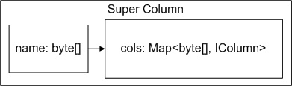
column
super
super columns group columns under a common name

Slide 66
super column family
<<SCF>>PointOfInterest
<<SC>>Central Park
<<SC>>
Empire State Bldg
10017
desc=Fun to walk in.
phone=212. 555.11212
desc=Great view from 102nd floor!
85255
<<SC>>
Phoenix Zoo

Slide 67
super column family
super column family
PointOfInterest {
key: 85255 {
Phoenix Zoo { phone: 480-555-5555, desc: They have animals here. },
Spring Training { phone: 623-333-3333, desc: Fun for baseball fans. },
}, //end phx
key: 10019 {
Central Park { desc: Walk around. It's pretty.} ,
Empire State Building { phone: 212-777-7777,
desc: Great view from 102nd floor. }
} //end nyc
}
column
key
super column
flexible schema
s

Slide 68
about super column families
sub-column names in a SCF are not indexed
top level columns (SCF Name) are always indexed
often used for denormalizing data from standard CFs

Slide 69
API
The Cassandra API consists of the following three simple methods.
insert(table; key; rowMutation)
get(table; key; columnName)
delete(table; key; columnName)

Slide 70
Read
Client
Query
Result
Cassandra Cluster
Closest replica
Result
Replica A
Digest Query
Replica B
Replica C

Slide 71

MongoDB
Built from the start to solve the scaling problem
Consistency, Availability, Partitioning
- (can’t have it all)
Configurable to fit requirements
Notes:
Dwight and Eliot had experience with this problem at Doubleclick – wanted to build the DB engine they wanted to have themselves.
Consistency, Availability, Partition tolerance (distributed)

Slide 72
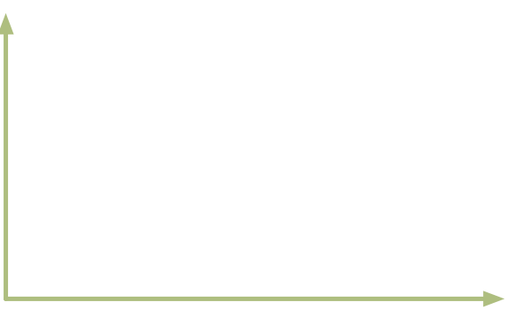


As simple as possible, but no simpler
Memcached
Key / Value
Scalability & Performance
RDBMS
Depth of functionality
Notes:
In memory Key value stores are very fast but not intuitive to map data to and no simple way to query except for Keys
RDBMS deep functionality but not fast plus normalized isn’t for most data types

Slide 73
Representing & Querying Data
Notes:
How different is functionality?

Slide 74


Terminology
RDBMS | MongoDB
Table | Collection
Row(s) | JSON Document
Index | Index
Join | Embedding & Linking
Notes:
BSON (binary JSON) – structured, flexible, express relations (but inside key/value pairs)

Slide 75
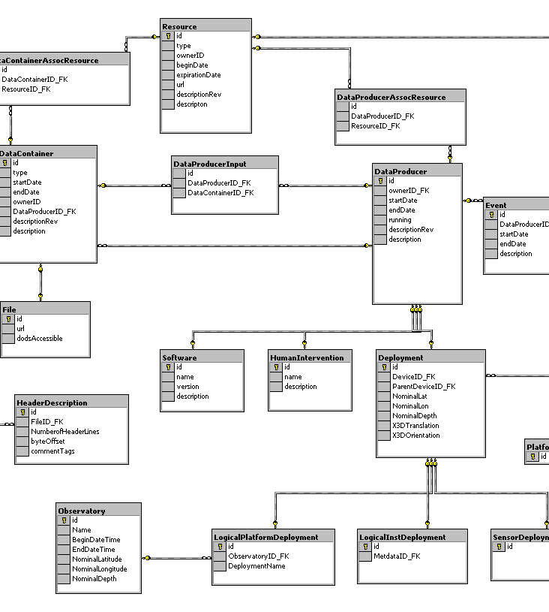
Tables to Collections of JSON Documents
{
title: ‘MongoDB’,
contributors:
[
{ name: ‘Eliot Horowitz’,
email: ‘eliot@10gen.com’ },
{ name: ‘Dwight Merriman’,
email: ‘dwight@10gen.com’ }
],
model:
{
relational: false,
awesome: true
}
}
Notes:
From tables of rows and columns to collections of JSON documents

Slide 76
Documents
Collections contain documents
Documents can contain other documents
and/or
Documents can reference other documents
Flexible/powerful ability to relate data
Schemaless
Flexible Schema
Notes:
Create, save and update documents (simple and readable)
BSON (binary JSON) – structured, flexible, express relations (but inside key/value pairs)
Documents are readable. Queryable, map well to your data structures in code.

Slide 77
Documents
var p = { author: “roger”,
date: new Date(),
title: “Spirited Away”,
avgRating: 9.834,
tags: [“Tezuka”, “Manga”]}
> db.posts.save(p)
Collection
Notes:
Create, save and update documents (simple and readable)

Slide 78
Linked vs Embedded Documents
{ _id : ObjectId("4c4ba5c0672c685e5e8aabf3"),
author : "roger",
date : "Sat Jul 24 2010 19:47:11 GMT-0700 (PDT)",
text : "Spirited Away",
tags : [ "Tezuka", "Manga" ],
comments : [ 6, 274, 1135, 1298, 2245, 5623],
avg_rating: 9.834 }
comments { _id : 274,
movie_id : ObjectId(“4c4ba5c0672c685e5e8aabf3”),
author : "Fred",
date : "Sat Jul 24 2010 20:51:03 GMT-0700 (PDT)",
text : "Best Movie Ever”}
{ _id : 275,
movie_id : ObjectId(“3d5ffc885599bcce34623”),
author : "Fred",
{ _id : ObjectId("4c4ba5c0672c685e5e8aabf3"),
author : "roger",
date : "Sat Jul 24 2010 …”,
text : "Spirited Away",
tags : [ "Tezuka", "Manga" ],
comments : [
{
author : "Fred",
date : "Sat Jul 26 2010…”,
text : "Best Movie Ever"
}
],
avgRating: 9.834 }
Notes:
Embedded (one read, get all) vs linked or referenced

Slide 79
Querying
>db.posts.find()
{ _id : ObjectId("4c4ba5c0672c685e5e8aabf3"),
author : "roger",
date : "Sat Jul 24 2010 19:47:11 GMT-0700 (PDT)",
text : "Spirited Away",
tags : [ "Tezuka", "Manga" ] }
Note:
- _id is unique, but can be anything you’d like
Notes:
_id is provided by mongodb if you don’t provide it yourself

Slide 80
Query Operators
Conditional Operators
$all, $exists, $mod, $ne, $in, $nin, $nor, $or, $size, $type
$lt, $lte, $gt, $gte
// find posts with any tags
> db.posts.find( {tags: {$exists: true }} )
// find posts matching a regular expression
> db.posts.find( {author: /^rog*/i } )
// count posts by author
> db.posts.find( {author: ‘roger’} ).count()

Slide 81
Atomic Operations
$set, $unset, $inc, $push, $pushAll, $pull, $pullAll, $bit
> comment = { author: “fred”,
date: new Date(),
text: “Best Movie Ever”}
> db.posts.update( { _id: “...” },
$push: {comments: comment} );

Slide 82
Indexes
Create index on any Field in Document
>db.posts.ensureIndex({author: 1})
// Index nested documents
> db.posts.ensureIndex( “comments.author”:1 )
> db.posts.find({‘comments.author’:’Fred’})
// Index on tags (array values)
> db.posts.ensureIndex( tags: 1)
> db.posts.find( { tags: ’Manga’ } )
// geospatial index
> db.posts.ensureIndex({ “author.location”: “2d” )
> db.posts.find( “author.location” : { $near : [22,42] } )

Slide 83
Aggregation/Batch Data Processing
Map/Reduce can be used for batch data processing
Currently being used for totaling, averaging, etc
Map/Reduce is a big hammer
Simple aggregate functions available
Aggregation Framework: Simple, Fast
No Javascript Needed, runs natively on server
Filter or Select Only Matching Sub-documents or Arrays via new operators
MongoDB Hadoop Connector
Useful for Hadoop Integration
Massive Batch Processing Jobs

